Slide 1




Cricket Tournament
Reg Id :20101040
Reg Id :20101043

Slide 2
Tables
Batsman | Type
Player_id | Varchar(20)
Player_name | Varchar(20)
Tm_id | Varchar(20)
Batting_style | Varchar(20)
Total_runs | Numeric(10)
Average | Numeric(5,2)
Top_score | Numeric(10)
Total_match_played | Numeric(10)
Strike_rate | Numeric(5,2)
100s | Numeric(10)
50s | Numeric(10)
Jersey_number | Numeric(10)
Primary key:player id Forien key:
Bowler | Type
Player_id | Varchar(20)
Tm_id | Varchar(20)
bowling_style | Varchar(20)
Average_speed | Numeric(5,2)
Highest_speed | Numeric(5,2)
Ecomomy_rate | Numeric(5,2)
bowling_average | Numeric(5,2)
best_bowling_figure | Numeric(5,2)
Bating_average | Numeric(5,2)
Jersey_number | Numeric(10)
Primary key:plyer id Forien key:
coach | type
coach_id | varchar(20)
coach_name | varchar(50)
country | varchar(100)
present_coach_of | varchar(100)
Primary key:coach id Forien key:
point | type
tm_id | varchar(20)
point | Numeric(4)
Primary key:tm_id Forien key:

Slide 3
Tables
Match | Type
match_id | varchar(20)
umpire1_name | varchar(50)
umpire1_id | varchar(20)
umpire2_name | varchar(50)
umpire2_id | varchar(20)
umpire3_name | varchar(50)
umpire3_id | varchar(20)
team1_name | varchar(50)
tm1_id | varchar(20)
team2_name | varchar(50)
tm2_id | varchar(20)
over | Numeric(5.2)
toss | varchar(100)
result | varchar(100)
match_status | varchar(100)
Primary key: match_id Forien key:
umpire | type
umpire_name | varchar(50)
umpire_id | varchar(20)
total_umpired_matches | Numeric(5)
country | varchar(50)
controversy | varchar(50)
Primary key: umpire_id Forien key:
schedule | type
schedule_id | varchar(20)
match_id | varchar(20)
venue | varchar(20)
country | varchar(20)
Stadium | varchar(100)
Time | date
Primary key: schedule_id Forien key:
player | type
player_id | varchar(20)
player_name | varchar(50)
date_of_birth | date
player_category | varchar(50)
batting_or_bowling_style | varchar(50)
country_name | varchar(50)
Primary key: player_id Forien key:

Slide 4
Tables
team | type
tm_id | varchar(20)
tm_name | varchar(50)
head_coach_id | varchar(20)
head_coach_name | varchar(100)
captain_id | varchar(20)
country_name | varchar(50)
tm_rank | Numeric(4)
Primary key: tm_id Forien key:
Match summary | type
match_id | varchar(20)
man_of_the_match | varchar(20)
top_run_scorer | varchar(20)
best_bowler | Varchar(20)
Primary key:

Slide 5
ER Diagram
umpire
team
batsmen
point
match
schedule
coach
player
blower
Match Summary

Slide 6
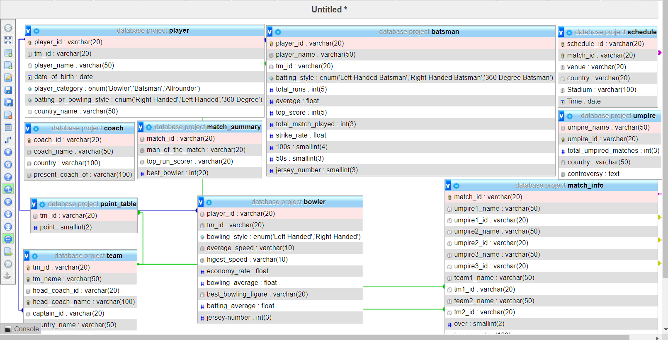

Slide 7



This Presentation is Prepared by
“Apurba Datta
Apurba Dey ”

